Slide 1


Project Proposal Defense
Presentation
On
AI For Skin Disease Detection
Presented By
AMISHA BASNET (28903/078)
SAISA KOIRALA (28932/078)
SANDESH KHATIWADA (28936/078)
Supervised By
Er. Dhiraj Kumar Jha

Slide 2
Presentation Outline
Introduction
Problem Statement
Algorithm Details
Data Processing ( Input , Processing and Output)
Testing Methodology
Final Outcomes

Slide 3
Introduction
Skin diseases affect millions globally and can lead to serious health risks if undiagnosed.
Early detection is critical, but limited access to dermatologists delays diagnosis.
AI and Deep Learning offer a solution for fast and accurate skin disease classification.
Our project uses image-based classification to assist in early detection.
Helps individuals take timely medical action and reduces pressure on healthcare services.

Slide 4
Problem Statement
The project aims to solve the challenge of delayed and inconsistent diagnosis of skin diseases due to the limited availability of expert dermatologists and the subjective nature of manual image interpretation.
An AI-based diagnostic tool can assist doctors by providing fast, consistent, and accessible preliminary assessments. It can reduce healthcare load, help prioritize urgent cases, and expand access to dermatological care.

Slide 5
Problem Statement
1. Background and Context
Skin diseases are among the most common health issues globally. However, access to accurate and early diagnosis remains a challenge. With advancements in AI and image classification, there is now potential to develop smart tools that assist healthcare professionals in identifying skin conditions from medical images.
2. The Problem
Traditional skin disease diagnosis requires dermatological expertise, which is not always available. Manual methods can be slow, costly, and prone to human error. The gap lies in the absence of an affordable, fast, and automated solution that can classify different skin conditions accurately.

Slide 6
Problem Statement
3. Significance of the Problem
This problem matters not just medically, but socially and technologically. Early diagnosis can save living standards. It also reduces the burden on healthcare providers and demonstrates how AI can have direct societal impact through medical imaging.
4.1 Objectives:
To build a deep learning model that classifies skin diseases using image data.
To evaluate and compare CNN, MobileNet, and DenseNet121 architectures.
To implement a basic web interface for user interaction.

Slide 7
Problem Statement
4.2. Scope:
The system will detect and classify skin diseases from images.
Focus will be on image-based classification only.
Live diagnosis or integration with medical devices is outside the current scope.
5 . Constraints:
The AI tool assumes input images are clear and properly formatted.
Model performance depends on the quality and diversity of the dataset.
It is intended as an assistive tool, not a certified diagnostic system.

Slide 8
Objectives (SMART Goals)
To develop an AI-based image classification model for skin disease detection using a structured dataset within the project timeline.
To train and evaluate CNN, MobileNet, and DenseNet121 models and compare their performance during the model evaluation phase.
To deploy the model through a basic web interface before final project submission.
To preprocess and structure the image dataset during the early development phase for optimal training.
To improve accessibility to dermatological screening by building a fast and consistent diagnosis support tool within the project duration.

Slide 9
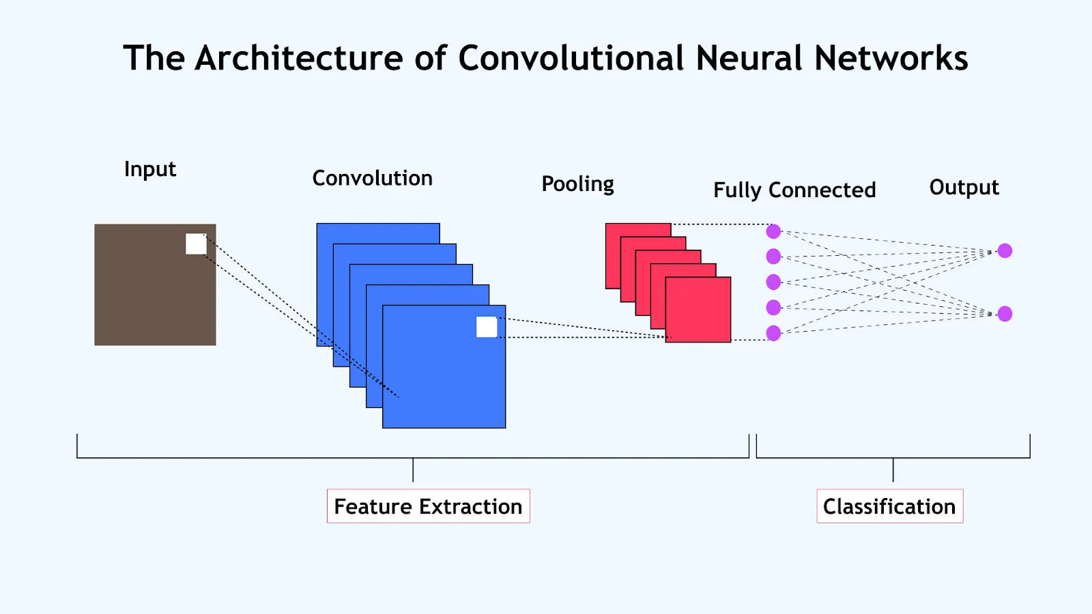
Algorithm Details
CNN (Convolutional Neural Network)
Extracts feature from input images through convolution and pooling layers.
Learns hierarchical pattern like edges, textures and shapes.
Ends with dense (fully connected) layer for classification.

Slide 10
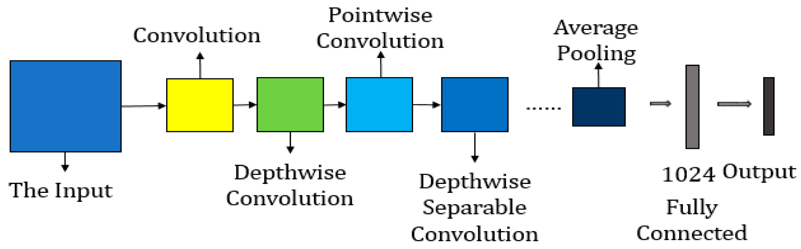
Algorithm Details
2. MobileNet
Lightweight pre-trained model optimized for speed and low resource usage.
Uses depth wise separable convolutions to reduce computation.
Trained on ImageNet, it’s adapted to classify skin diseases with transfer learning.

Slide 11
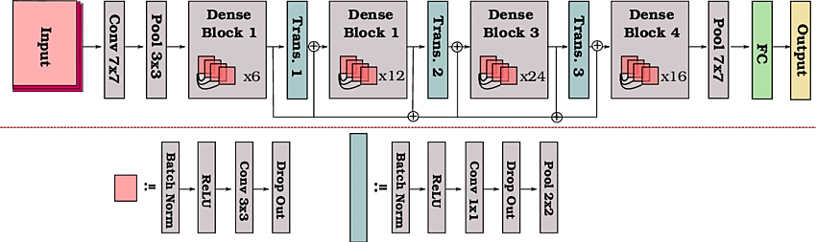
Algorithm Details
3. DenseNet121
High-performance pre-trained model used for accurate disease detection.
Features are reused via dense connections, improving learning and
reducing vanishing gradient problems.
Fine-tuned on a clinical image dataset from Kaggle for classifying various
skin diseases.

Slide 12
Data Processing ( Input-Processing-Output)
a. Input Stage
Dataset of skin disease images from Kaggle - DermNet Dataset
dataset includes 900 images to classify 9 diseases (80:20 train-test split).
Format: Mostly JPG (RGB) with varying resolutions and quality

Slide 13
Data Processing ( Input-Processing-Output)
b. Processing Stage
Image resizing: All images resized to 240×240 pixels to match model input requirements
Normalization: Pixel values scaled between 0 and 1 for efficient neural network training
Label encoding: Disease category names converted to integer labels, then one-hot encoded for multi-class classification
Data splitting: Images divided into training and validation subsets

Slide 14
Data Processing ( Input-Processing-Output)
c. Output Stage
Preprocessed image data ready for model training and evaluation
Labels prepared for multi-class classification
Improved dataset quality and size enabling better model accuracy and generalization

Slide 15
Testing Methodology
Dataset Split: The Dataset consists of approximate 900 labeled images, covering 9 distinct skin disease categories. An 80:20 ratio is used to split the data in training and testing sets.
Training and Validation: During training, the dataset is further split into training and validation sets to monitor the model’s performance and prevent overfitting.

Slide 16
Testing Methodology
Testing: After training, the model is tested on the separate test set to assess its ability to generalize to new, unseen skin disease images.
Evaluation Metrics:
Accuracy: Measures the percentage of correctly classified images.
Loss: Quantifies the error between predicted and true labels.
Confusion Matrix: Visualizes the model’s classification performance across all skin disease classes.

Slide 17
Project Outcome and Deliverables
Final Goal: To develop an AI-powered skin disease detection system that can accurately classify images of skin lesions into different disease categories using deep learning models.
What You Will Achieve?
A user-friendly interface where users can upload a skin lesion image.
The system processes the image and predicts the most likely skin disease from the trained model.
Clear display of prediction results with confidence scores.

Slide 18
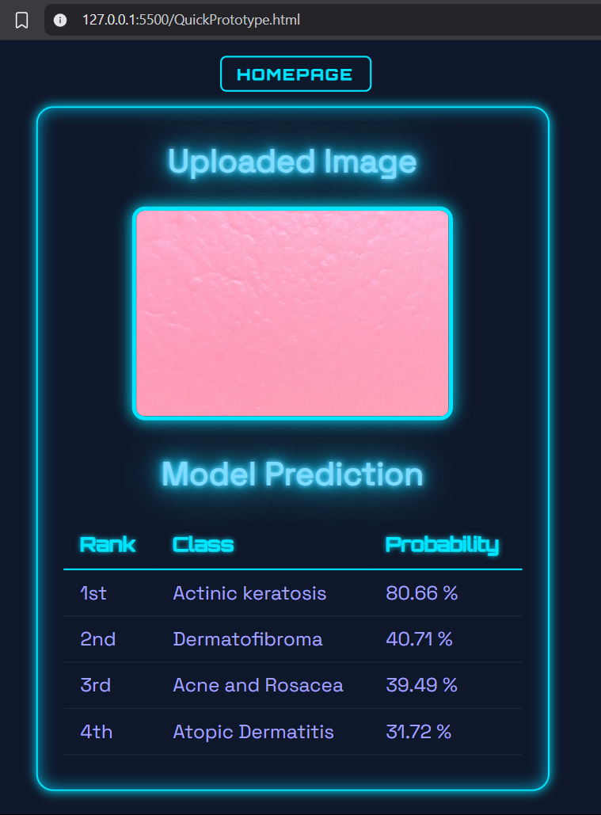
Project Outcome and Deliverables
Interface Design (Wireframes / Prototype):
Home Page: Simple upload form for images.
Result Page: Shows the uploaded image and predicted disease with explanation.

Slide 19
Project Outcome and Deliverables
Why This is Realistic:
Using pre-trained models like DenseNet121 and MobileNet speeds up development.
The dataset provides sufficient and labeled images for training and testing.
Training and evaluation can be done within the course timeline.
Web-based interface development which is done with basic Flask framework.

Slide 20
Thank you

